Slide 1

Analyzing Risk of Diabetes & High Blood Pressure
Foziea, Rimi, Romane, Meklit, Alicia, Carina
Notes:
Romane

Slide 2
What is Diabetes?
Motivation & Application
The data
Features
Libraries
Visualizations
Algorithm
Website
Impact on Society & Ethics
Data Privacy
Sources
Table of Contents
Notes:
Romane

Slide 3
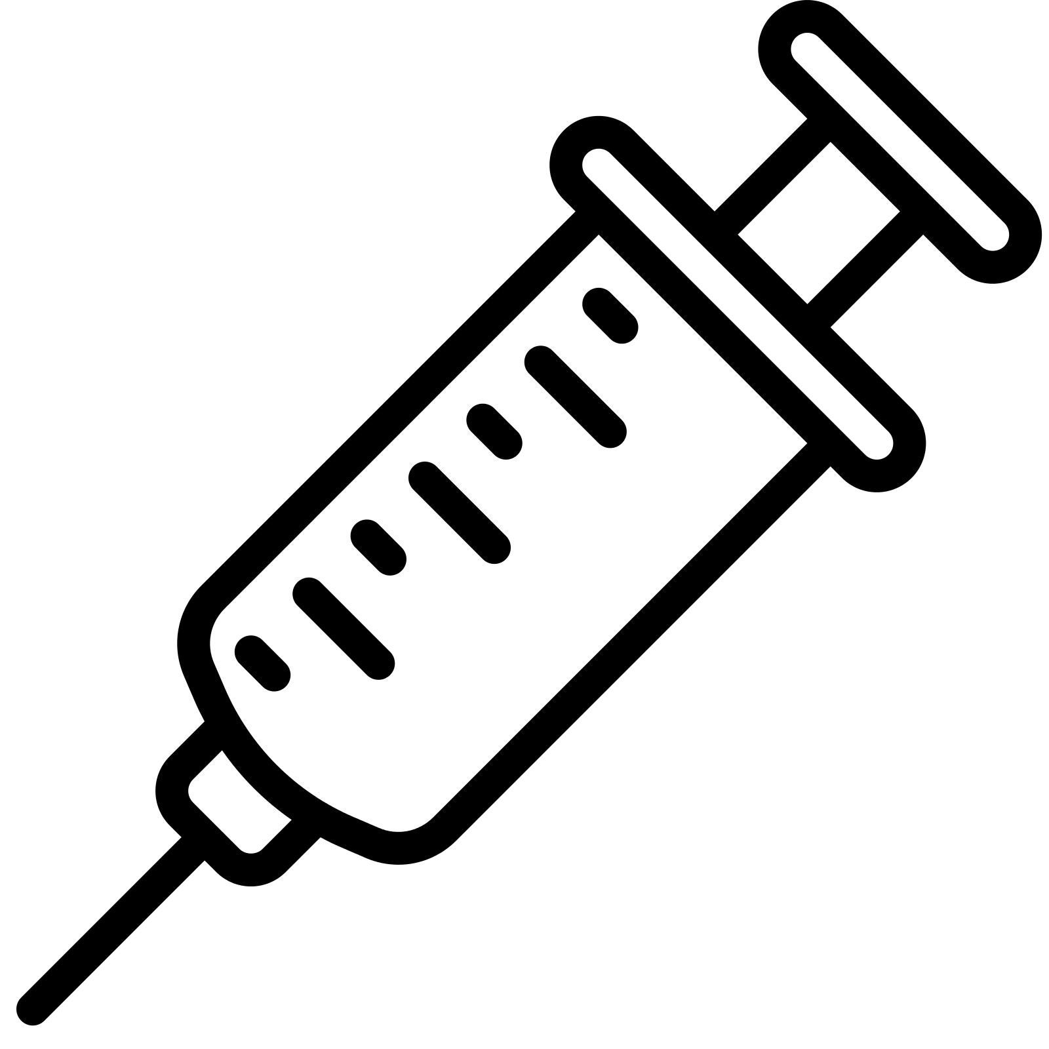
What is Diabetes?
According to the CDC, “Diabetes is the condition in which the body does not properly process food for use as energy”
Most of the food is turned into glucose (sugar) for energy but with diabetes, your body either doesn't make enough insulin or can't use its own insulin as well as it should
Currently diabetes is the seventh leading cause of death in the US, and can cause numerous other serious health complications

Slide 4
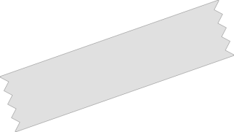

Motivations & Applications
Since we all have an interest in how AI can be used to improve the health & medicine field, our group knew we wanted to create an application that would hopefully not only be able to aid a patient, but the doctor as well.
In 2012, researchers found that about 30% of people with type 1 diabetes and 50-80% of people with type 2 have high blood pressure in the United States. Not only that, about 2.2 million deaths were due to high blood glucose in 2012.
Many of us have personal experience encountering high blood sugar or know people who have and self monitoring by paper can be disorganized. With our idea we will be able to help doctors access patient information faster as well as help patients monitor their blood glucose levels in an organized manner.
Old Technology-
Self monitoring is a form of measuring a diabetic/pre-diabetic patient’s blood glucose levels using a glycemic reader. Traditionally, the patient writes down these levels and shows them to their doctor, who then gives them advice on how to adjust diet, exercise etc.
With Our Application-
Patients will be able to input their self-monitored blood-glucose levels into our website and the doctor will be able to access this information easily. The algorithm will also be able to provide feedback as well as be able to predict predict the likelihood of diabetes and hypertension from the trends.
Notes:
Rimi

Slide 5
The data.
We will create the algorithm based on data collected by the National Institute of Diabetes and Digestive and Kidney Diseases here: Diabetes Data Set | Kaggle. This specific dataset includes all patients who are females that are at least 21 years old of Pima Indian heritage. Due to this our algorithm will only be targeting females. Our dataset is also relatively small with only 768 data points.
We decided to use this specific dataset since the data is derived by a trusted and reliable institution who has years of experience studying various kidney diseases.
Notes:
Patients being monitored for diabetes and high blood pressure usually record their blood sugar and pressure levels at home before showing them to a doctor at check-ups. With our idea, patients would instead enter that data into our algorithm which would predict the likelihood of them being diagnosed with diabetes and/or high blood pressure, as well as analyze their progress. We will create the algorithm based on data collected by the National Institute of Diabetes and Digestive and
With our idea, patients would enter their measured glucose and BP levels into our medium where the algorithm will visualize the data and eventually predict the likelihood of diabetes and hypertension from the trends.
Kidney Diseases, linked here Diabetes Data Set | Kaggle

Slide 6
FEATURES
These are features that our algorithm will use to predict risk of diabetes, after patients self-report their data
Glucose (Plasma glucose concentration a 2 hours in an oral glucose tolerance test)
Blood Pressure (Diastolic blood pressure (mm Hg))
BMI (weight in kg/(height in m)^2)
Age (years)
Insulin (2-Hour serum insulin (mu U/ml))
Number of Pregnancies
Notes:
Meklit
Widnie- Consider this for slide 3: “With our idea, patients would enter their measured glucose and BP levels into our medium where the algorithm will visualize the data and eventually predict the likelihood of diabetes and hypertension from the trends.
Patients will be able to input their self-monitored blood-glucose levels into our medium and our algorithm will be able to visualize the data and predict the likelihood of high blood pressure from trends

Slide 7
Libraries We Used
pandas - an open source Python package that is used for data science/data analysis and machine learning tasks
numpy - an open-source numerical Python library that contains a multi-dimensional array and matrix data structures
seaborn - a library for making statistical graphics in Python that builds on top of matplotlib and integrates closely with pandas data structures
Notes:
Carina

Slide 8
What We Used To Create Our Visualizations
Our visualizations were created using Matplotlib and importing pyplot.
Code
Notes:
Foziea
Kidney Diseases, linked here Diabetes Data Set | Kaggle

Slide 9
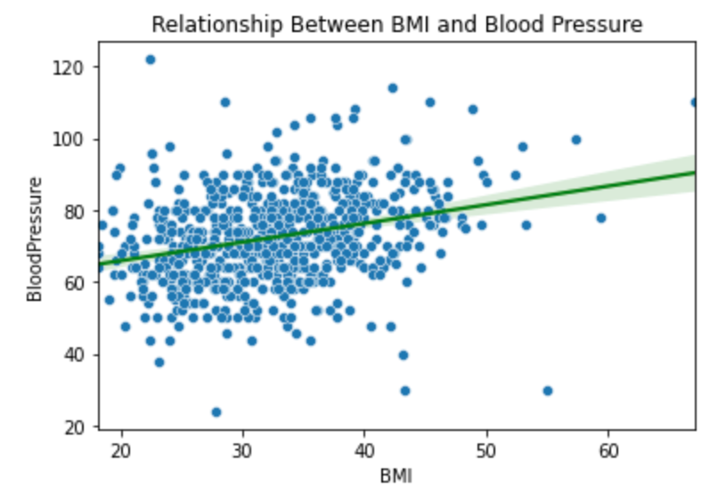
Visualizations
BMI vs Blood Pressure
As is evident by the graph there is a somewhat positive relationship between the two suggesting that a higher BMI is associated with increased BP.
Notes:
Foziea
Patients being monitored for diabetes and high blood pressure usually record their blood sugar and pressure levels at home before showing them to a doctor at check-ups. With our idea, patients would instead enter that data into our algorithm which would predict the likelihood of them being diagnosed with diabetes and/or high blood pressure, as well as analyze their progress. We will create the algorithm based on data collected by the National Institute of Diabetes and Digestive andWith our idea, patients would enter their measured glucose and BP levels into our medium where the algorithm will visualize the data and eventually predict the likelihood of diabetes and hypertension from the trends.
Kidney Diseases, linked here Diabetes Data Set | Kaggle

Slide 10
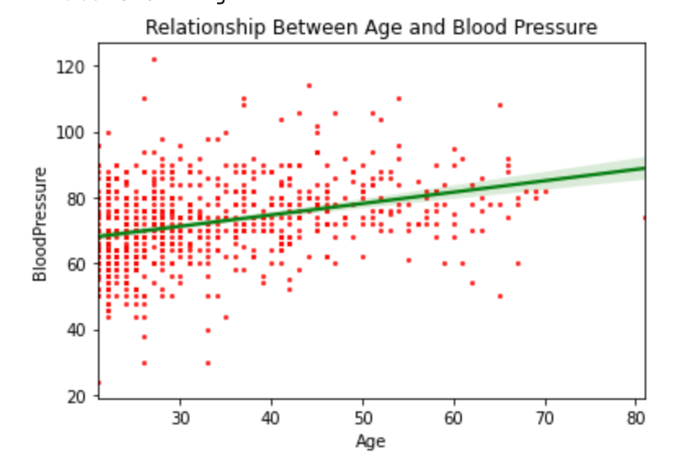
Visualizations
Age vs Blood Pressure
As is evident by the graph your risk for high blood pressure increases the older that you get.
Notes:
Foziea
Patients being monitored for diabetes and high blood pressure usually record their blood sugar and pressure levels at home before showing them to a doctor at check-ups. With our idea, patients would instead enter that data into our algorithm which would predict the likelihood of them being diagnosed with diabetes and/or high blood pressure, as well as analyze their progress. We will create the algorithm based on data collected by the National Institute of Diabetes and Digestive and
With our idea, patients would enter their measured glucose and BP levels into our medium where the algorithm will visualize the data and eventually predict the likelihood of diabetes and hypertension from the trends.
Kidney Diseases, linked here Diabetes Data Set | Kaggle

Slide 11
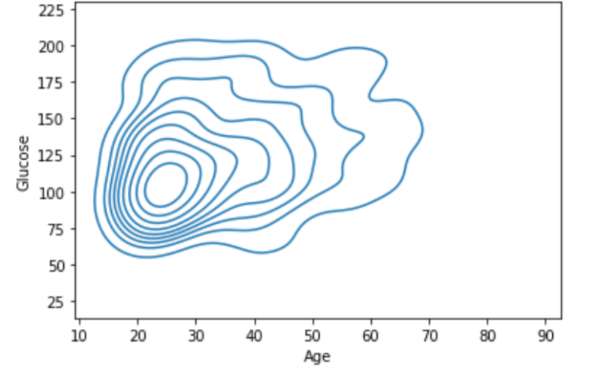
Visualizations
Glucose v Age
Glucose levels are a very important factor in determining risk of diabetes. Here, it is clear that the older the age, the more spread out and extreme the glucose levels become.
Notes:
Foziea
Patients being monitored for diabetes and high blood pressure usually record their blood sugar and pressure levels at home before showing them to a doctor at check-ups. With our idea, patients would instead enter that data into our algorithm which would predict the likelihood of them being diagnosed with diabetes and/or high blood pressure, as well as analyze their progress. We will create the algorithm based on data collected by the National Institute of Diabetes and Digestive and
With our idea, patients would enter their measured glucose and BP levels into our medium where the algorithm will visualize the data and eventually predict the likelihood of diabetes and hypertension from the trends.
Kidney Diseases, linked here Diabetes Data Set | Kaggle

Slide 12
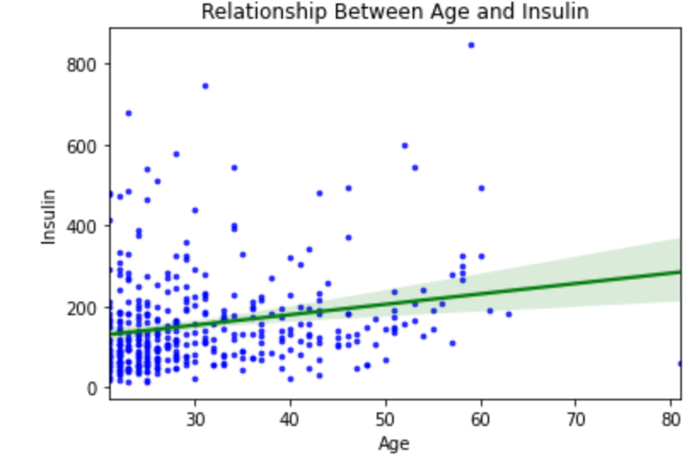
Visualizations
Age vs Insulin
This depicts a slight increase in insulin levels as age increases, as well as more frequent extreme levels.
Notes:
Foziea
Patients being monitored for diabetes and high blood pressure usually record their blood sugar and pressure levels at home before showing them to a doctor at check-ups. With our idea, patients would instead enter that data into our algorithm which would predict the likelihood of them being diagnosed with diabetes and/or high blood pressure, as well as analyze their progress. We will create the algorithm based on data collected by the National Institute of Diabetes and Digestive and
With our idea, patients would enter their measured glucose and BP levels into our medium where the algorithm will visualize the data and eventually predict the likelihood of diabetes and hypertension from the trends.
Kidney Diseases, linked here Diabetes Data Set | Kaggle

Slide 13
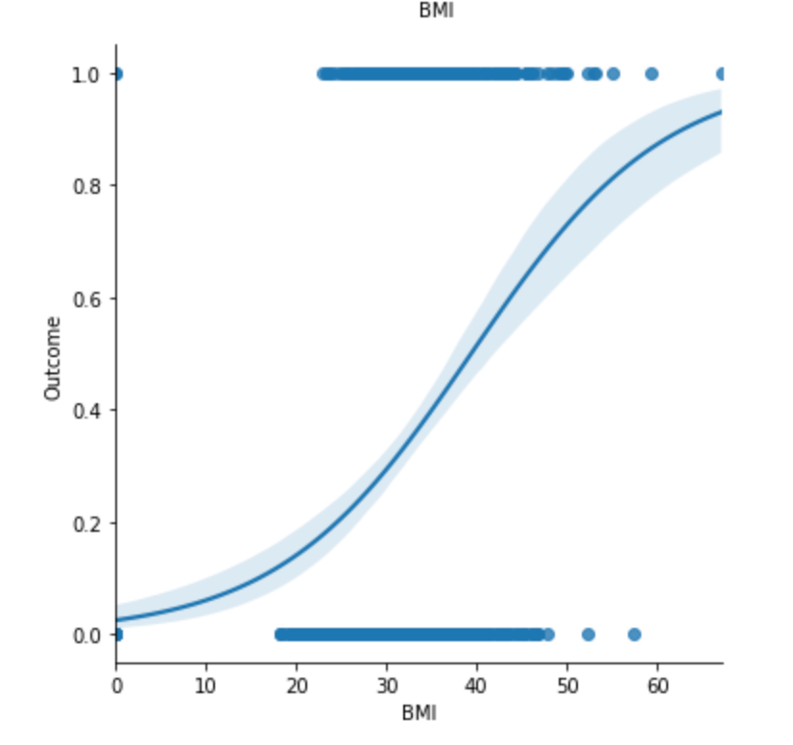
Visualizations
BMI vs Outcome
In this graph we can see that as one’s BMI increases the likelihood of them having diabetes also significantly increases.
Notes:
Foziea
Patients being monitored for diabetes and high blood pressure usually record their blood sugar and pressure levels at home before showing them to a doctor at check-ups. With our idea, patients would instead enter that data into our algorithm which would predict the likelihood of them being diagnosed with diabetes and/or high blood pressure, as well as analyze their progress. We will create the algorithm based on data collected by the National Institute of Diabetes and Digestive and
With our idea, patients would enter their measured glucose and BP levels into our medium where the algorithm will visualize the data and eventually predict the likelihood of diabetes and hypertension from the trends.
Kidney Diseases, linked here Diabetes Data Set | Kaggle

Slide 14
Algorithm (Logistic Regression)
What Is Logistic Regression and Why We Chose It
A logistic regression is a classification algorithm used to predict a binary outcome based on a set of independent variables. This algorithm has a range between 0 and 1 and it is used for binary classification.
This best fits our situation because in the case of our data there are only two outcomes: a diagnosis of diabetes or no diabetes.
Notes:
Meklit

Slide 15
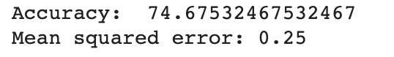
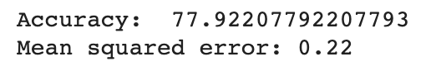
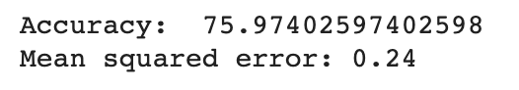
Algorithm cont.
Accuracy: 70-80%
Jupyter Notebook
Test Set vs. Training Set
80% of the data was used to train the model while the remaining 20% was used to test the model.
Final Conclusion
When we ran our algorithm we found that the accuracy lied around 70-80%. In terms of prediction this is really good. At this point in time this technology would only supplement your doctors visit and if you get worrying results you should confirm with a real diagnosis. While at this moment this wouldn’t replace a professional diagnosis it is possible in the future that maybe with more data and different features you may not need to go to the doctor to get a diagnosis for diabetes.
Notes:
Meklit

Slide 16
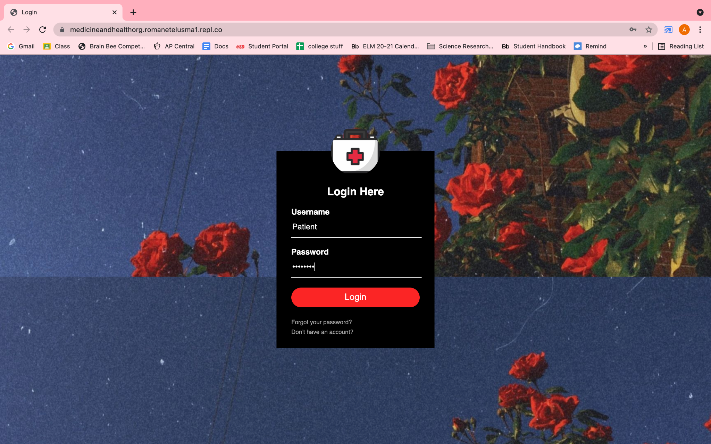
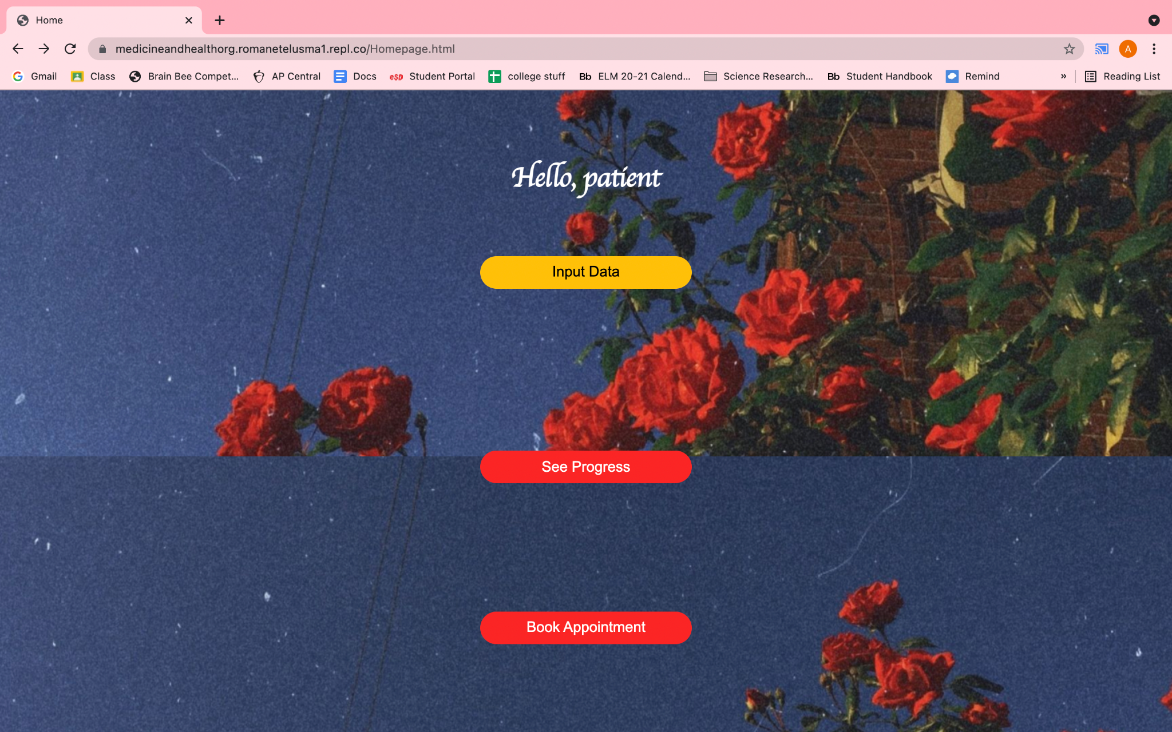
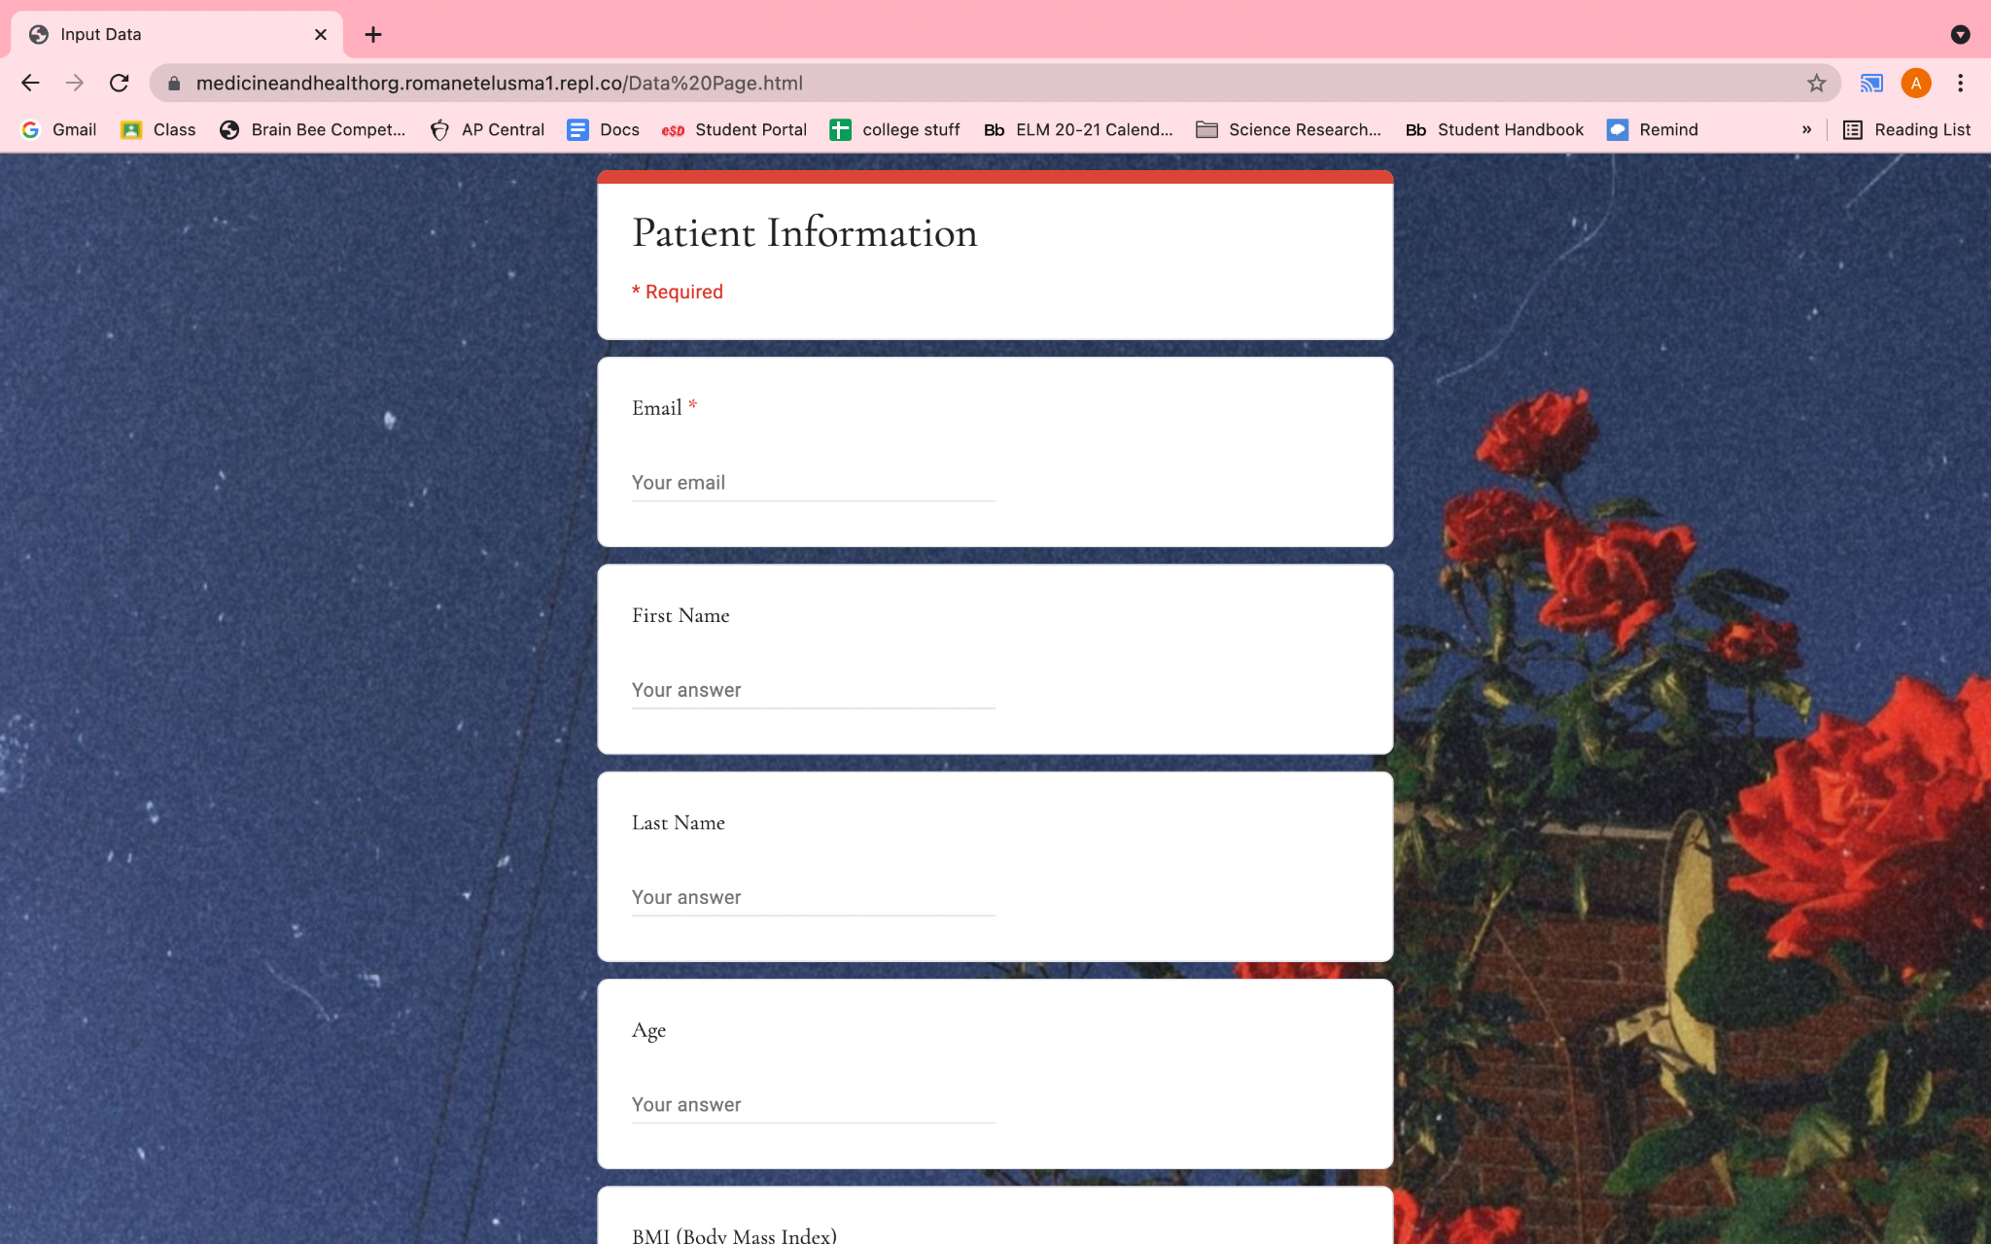
Website
Login Page
Home Page
Form Page
Link: https://medicineandhealthorg.romanetelusma1.repl.co/
Notes:
Romane

Slide 17

Website
Link: https://medicineandhealthorg.romanetelusma1.repl.co/
Notes:
Romane

Slide 18
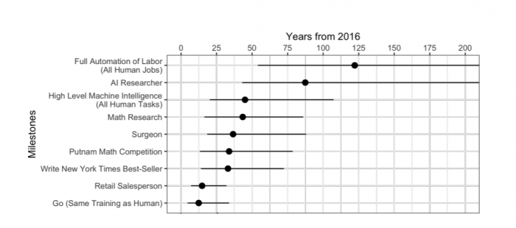
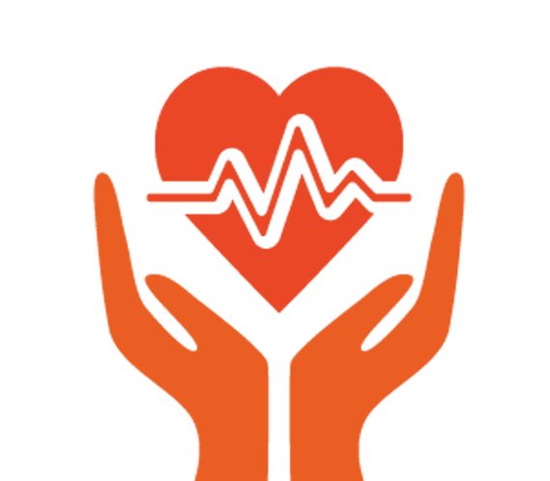
Impact on Society
With the advancement of technology as well as the growing applications of artificial intelligence in healthcare, there are positive and negative effects that have to be taken into consideration. Our application reduces the amount of doctor visits and not only increases efficiency for patients but also the doctor. Both patients and doctors can easily keep track of a patient’s health and treatment progress through a virtual platform. Patients can also figure out what steps to take next in terms of their diet and exercise levels without having to re-visit their doctors constantly for advice.
Source- Oxford University / Yale University
This is a graph that expresses the increase of artificial intelligence in a variety of STEM based fields over the past couple of years.
With this rapid increase in automated labor, many express their concerns of artificial intelligence replacing actual physicians. However, especially in light of the recent pandemic, the United States has faced a shortage of physicians. Our application doesn’t get rid of the need for doctors, but does get rid of tedious doctor visits. This can also help decrease burnout in physicians as it leaves extra time for them to attend to other patients and tasks.
Notes:
Rimi

Slide 19
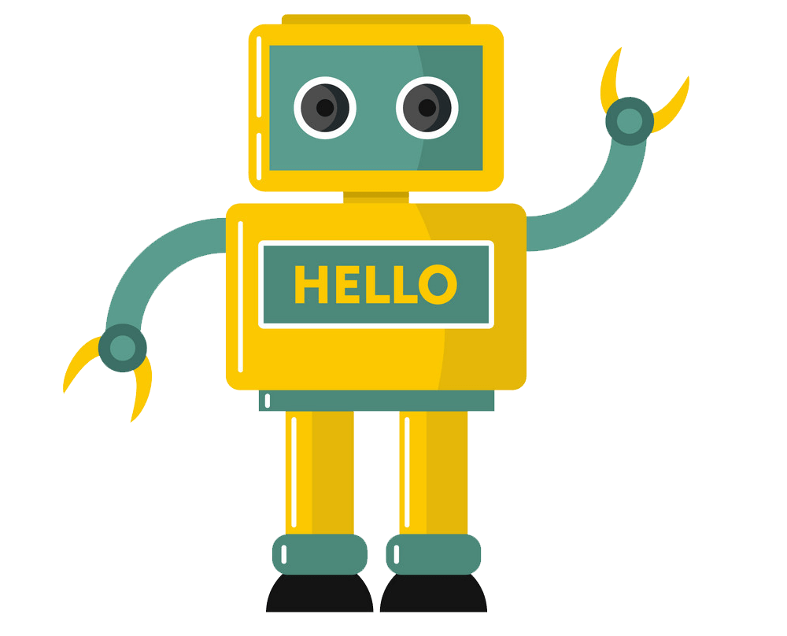
Ethics
Due to private patient information input into an online platform, there come many privacy and bias concerns.
A study from the University of California Berkeley states that advances in artificial intelligence have rendered the Health Insurance Portability and Accountability Act of 1996 (HIPAA) obsolete, meaning no longer in use. However, through a consumer’s healthcare data, AI can be utilized by suggesting diagnoses, more accurately interpreting medical device images, increasing the rate of medical development, and more.
On the other hand, insurance companies can also use consumer healthcare information for biased categorizing and economic profit.
The question that comes into play now is how can we find a balance between using AI for important medical research and violations of data privacy & ethics?
Although we cannot completely guarantee that these rising privacy concerns surrounding AI will be put to rest, since our application does not exploit patient information or take away a physician's job, it is completely ethical. The patient also dictates which of their personal information they want to put into our application.
Notes:
Rimi

Slide 20
Data Privacy
The privacy of our users and the protection of their data is one of our biggest concerns
Our users will not have to worry about us selling their data or using it against the law
W ensure that your data is safeguarded from unlawful access by unauthorized parties
Notes:
Carina

Slide 21
Sources:
Bresnick, Jennifer. “Arguing the Pros and Cons of Artificial Intelligence in Healthcare.” Health IT Analytics, 17 July 2018, healthitanalytics.com/news/arguing-the-pros-and-cons-of-artificial-intelligence-in-healthcare.
“Diabetes Data Set.” Kaggle, 5 Aug. 2020, www.kaggle.com/mathchi/diabetes-data-set/tasks.
Kulkarni, Andrea. “AI in Healthcare: Data Privacy and Ethics Concerns.” Lexalytics, 15 June 2021, www.lexalytics.com/lexablog/ai-healthcare-data-privacy-ethics-issues.
Rençberoğlu, Emre. “Fundamental Techniques of Feature Engineering for Machine Learning.” Medium, 3 Apr. 2019, towardsdatascience.com/feature-engineering-for-machine-learning-3a5e293a5114.
“Self-Monitoring of Blood Glucose.” Diabète Québec, 27 Sept. 2019, www.diabete.qc.ca/en/living-with-diabetes/care-and-treatment/self-control/self-monitoring-of-blood-glucose/#:%7E:text=Self%2DMonitoring%20of%20Blood%20Glucose%20(SMBG)%20is%20an%20approach,%2C%20antidiabetics%2C%20stress%20management).
Thank you so much to our instructors Widnie Pierre-Louis & Jacques Hughes as well for the amazing guidance and help throughout this project.

Slide 22
Contact Us
Foziea: foziea.g@gmail.com
Alicia josephalicia@sewanhakaschools.org
Rimi- nigar.rimi@brooklynlatin.org
Carina: carinapan12@gmail.com
Notes:
Foziea
Kidney Diseases, linked here Diabetes Data Set | Kaggle

